Slide 1






&
A love story
Martin Björkström
Swetugg 2020
@mholo65
Notes:
Irinas talk about Messaging in Microservices?
When to use messaging, when to use RPC.

Slide 2





Martin Björkström
Freelance Software Developer
OSS Maintainer & Contributor
Microsoft MVP
https://github.com/mholo65/grpc-talk
@mholo65
@mholo65

Slide 3
https://github.com/mholo65/grpc-talk
Notes:
How many have used gRPC?

Slide 4
“In distributed computing, a remote procedure call (RPC) is when a computer program causes a procedure (subroutine) to execute in a different address space (commonly on another computer on a shared network), which is coded as if it were a normal (local) procedure call, without the programmer explicitly coding the details for the remote interaction.”
Wikipedia contributors, "Remote procedure call," Wikipedia, The Free Encyclopedia, https://en.wikipedia.org/w/index.php?title=Remote_procedure_call&oldid=935411446 (accessed January 30, 2020).
Notes:
Because everything that is on Wikipedia is true.

Slide 5
gRPC
Client
Server
Remote Procedure Call (RPC) Framework
Grpc.Core and grpc-dotnet
Multi-language support
Protocol Buffers by default
Payload
Interface Description Language (IDL)
Application
Application
Client Stub
Server Stub
RPC Runtime
RPC Runtime
Transport
Transport
Notes:
Developer Productivity and Performance
Born from Stubby (Google)
Announced in 2015 (Released in 2016)
gRPC Remote Procedure Calls (recursive acronym)
'g' stands for something different every gRPC release
.NET ecosystem since beginning
Cloud Native Computing Foundation project
HTTP/2
C++, Java, Objective-C, Python, Ruby, Go, C#, etc.

Slide 6

Protocol Buffers

Slide 7
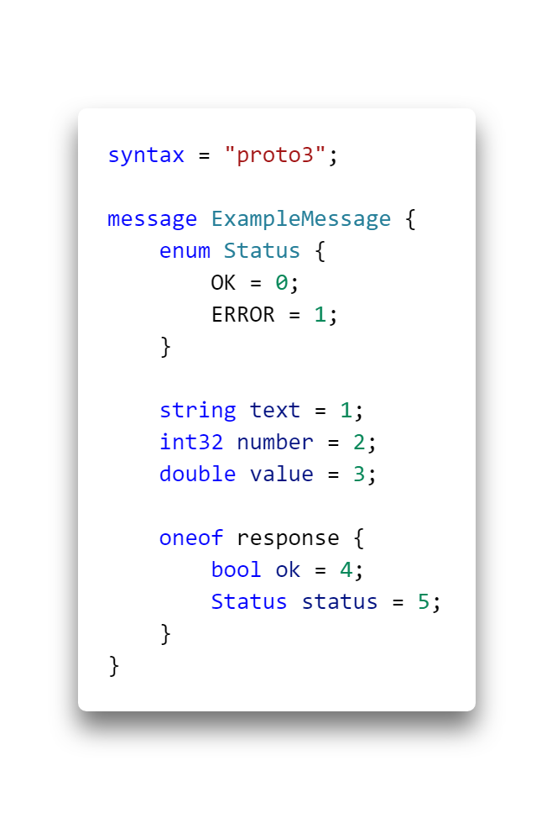
Protocol Buffers
Data interchange format
Interface Description Language (IDL)
Not self-describing
Multi-language support
Google.Protobuf and Protobuf-net
Notes:
Google's data interchange format
Serialization of structured data
Initially developed and used at Google, open-sourced 2008
A language-neutral, platform-neutral extensible mechanism for serializing structured data
Supported by a wide range of programming languages
C++, Java, Objective-C, Python, Ruby, Go, C#, etc.
Protobuf-net (Marc Gravell), protobuf-csharp-port (Jon Skeet Java port), later Google.Protobuf

Slide 8
Getting started
Notes:
Interface Description Language = Schema
Generated to C# code.
No magic.

Slide 9
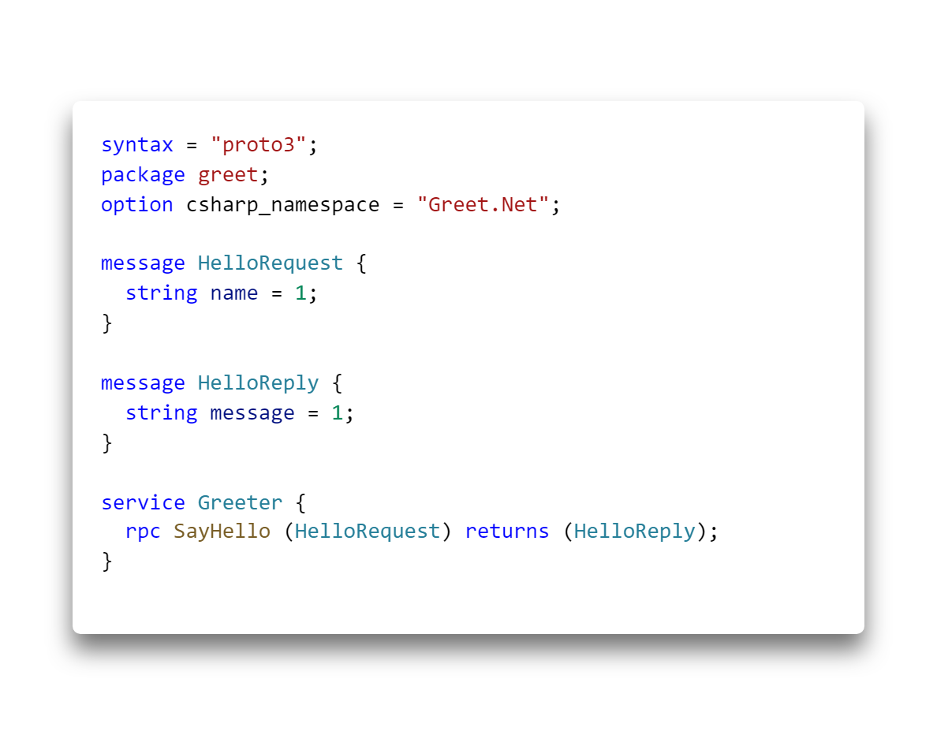

Slide 10
Notes:
Namespace, default package

Slide 12
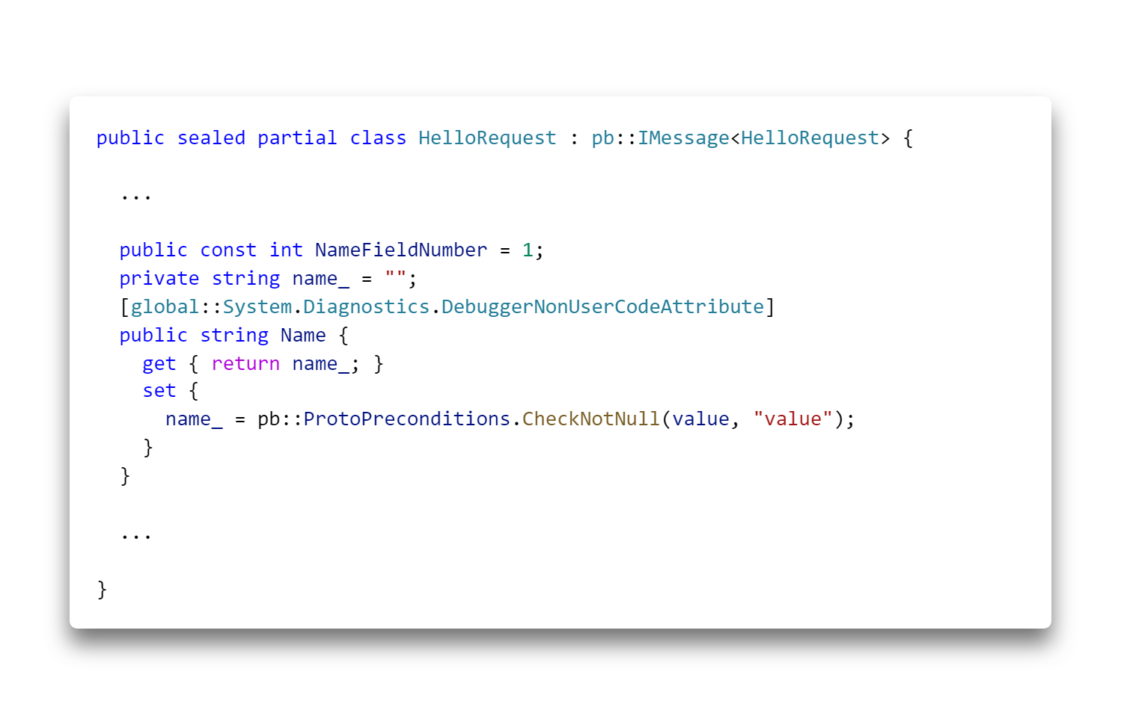
Notes:
Default value, not null

Slide 13
Notes:
Simplue unary call

Slide 14
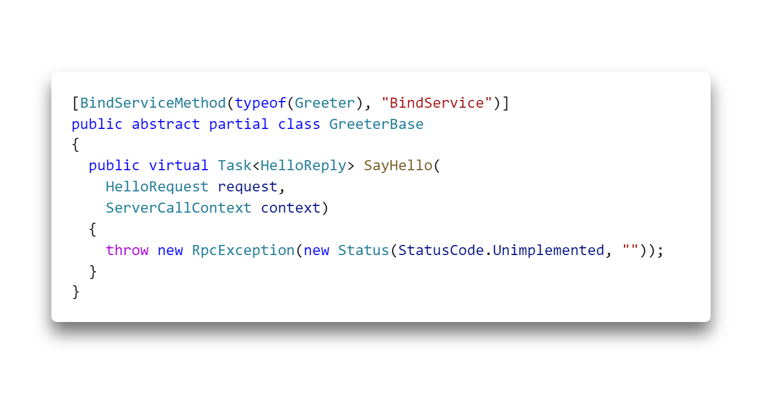
Notes:
server

Slide 15
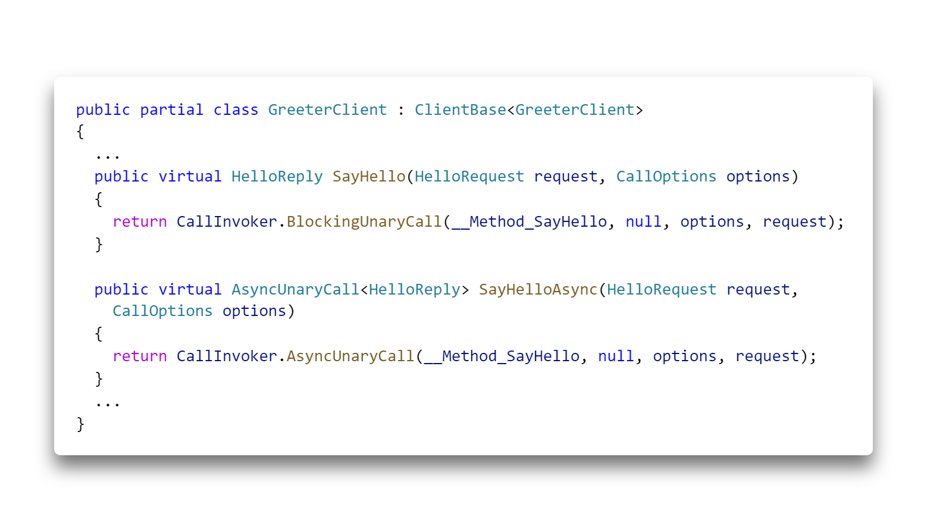
Notes:
client

Slide 16
NuGet Packages

Slide 17
grpc-dotnet
Grpc.Core
Grpc.Core.Api
Shared
Grpc.Core
Grpc.AspNetCore.Server
Grpc.Net.Client
Grpc.Tools
Grpc.AspNetCore.Server .ClientFactory
Grpc.Net.ClientFactory
Google.Protobuf
Grpc.AspNetCore

Slide 18
grpc-dotnet
Grpc.Core
Grpc.Core.Api
Shared
Grpc.Core
Grpc.AspNetCore.Server
Grpc.Net.Client
Grpc.Tools
Grpc.AspNetCore.Server .ClientFactory
Grpc.Net.ClientFactory
Google.Protobuf
Grpc.AspNetCore
Notes:
Shared packages
Core gRPC surface API, no dependency on Protobuf
Grpc Tools produces Grpc.Core.Api and Google.Protobuf compatible code.

Slide 19
grpc-dotnet
Grpc.Core
Grpc.Core.Api
Shared
Grpc.Core
Grpc.AspNetCore.Server
Grpc.Net.Client
Grpc.Tools
Grpc.AspNetCore.Server .ClientFactory
Grpc.Net.ClientFactory
Google.Protobuf
Grpc.AspNetCore
Notes:
Grpc.Core – Native – 90MB
- Client and Server
Managed wrapper around C/C++ (P/Invoke)
Same native library used for Python, PHP, Ruby, Objective-C

Slide 20
grpc-dotnet
Grpc.Core
Grpc.Core.Api
Shared
Grpc.Core
Grpc.AspNetCore.Server
Grpc.Net.Client
Grpc.Tools
Grpc.AspNetCore.Server .ClientFactory
Grpc.Net.ClientFactory
Google.Protobuf
Grpc.AspNetCore
Notes:
Managed (gRPC for ASP.NET Core)
Grpc.AspNetCore – An ASP.NET Core framework for hosting gRPC services. gRPC on ASP.NET Core integrates with standard ASP.NET Core features like logging, dependency injection (DI), authentication and authorization.
Known programming model, plugs into ASP.NET Core
Depenency Injection, etc...
Metapackage include all
Client HttpClientFactory integration

Slide 21
grpc-dotnet
Grpc.Core
Grpc.Core.Api
Shared
Grpc.Core
Grpc.AspNetCore.Server
Grpc.Net.Client
Grpc.Tools
Grpc.AspNetCore.Server .ClientFactory
Grpc.Net.ClientFactory
Google.Protobuf
Grpc.AspNetCore
Notes:
Client only
Grpc.Net.Client – A gRPC client for .NET Core that builds upon the familiar HttpClient. The client uses new HTTP/2 functionality in .NET Core.
Grpc.Net.ClientFactory – gRPC client integration with HttpClientFactory. The client factory allows gRPC clients to be centrally configured and injected into your app with DI.

Slide 22
Putting it all together Grpc.Core
Notes:
Native implementation

Slide 23
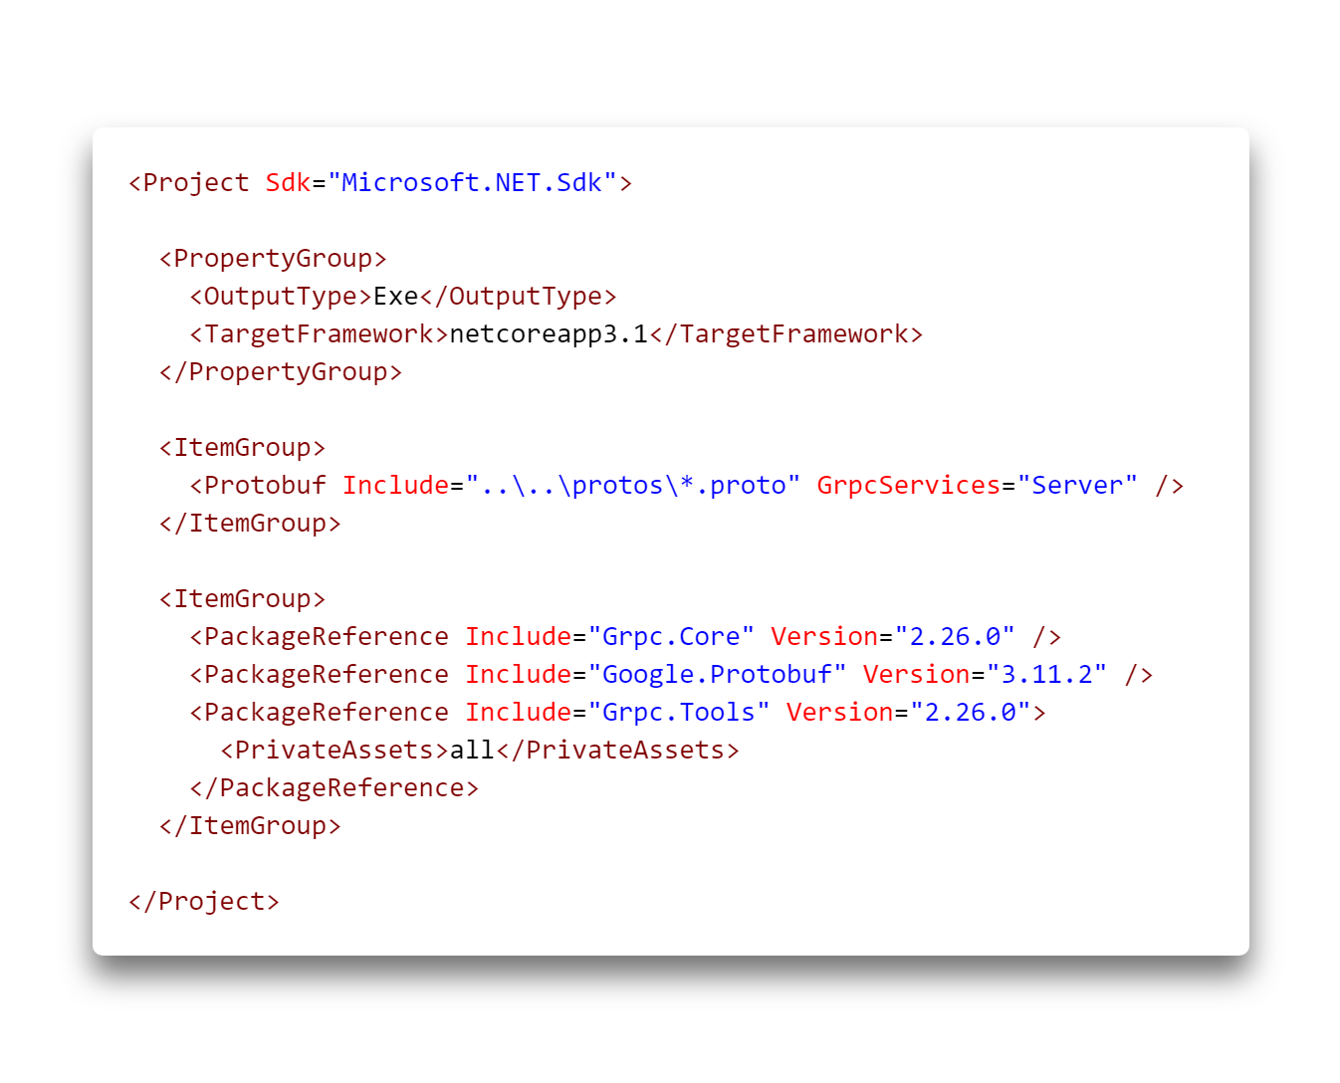

Slide 24
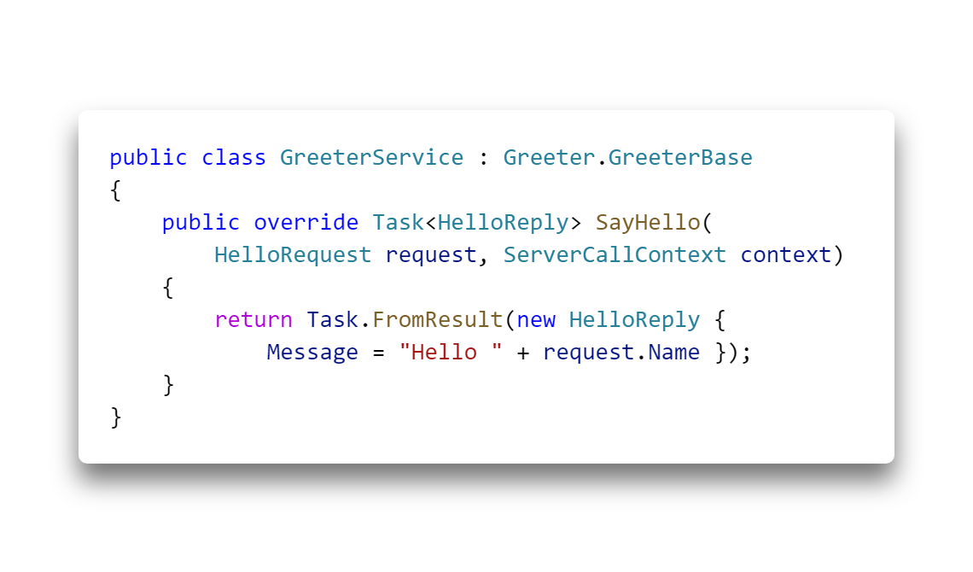

Slide 25
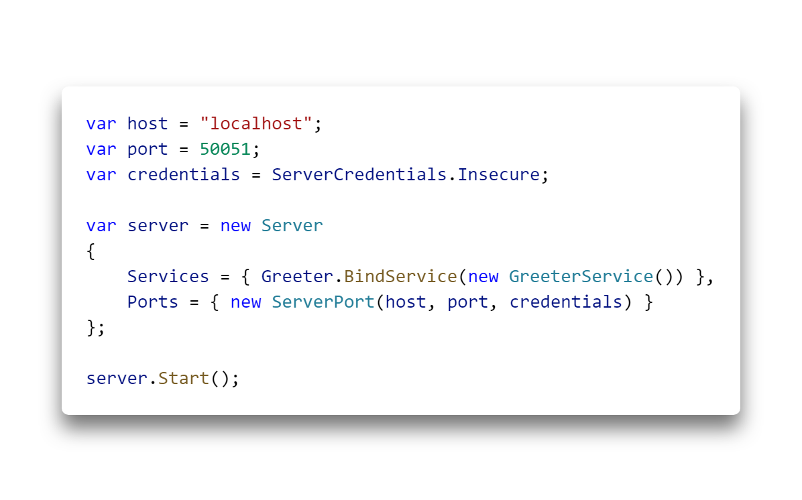

Slide 26


Slide 27
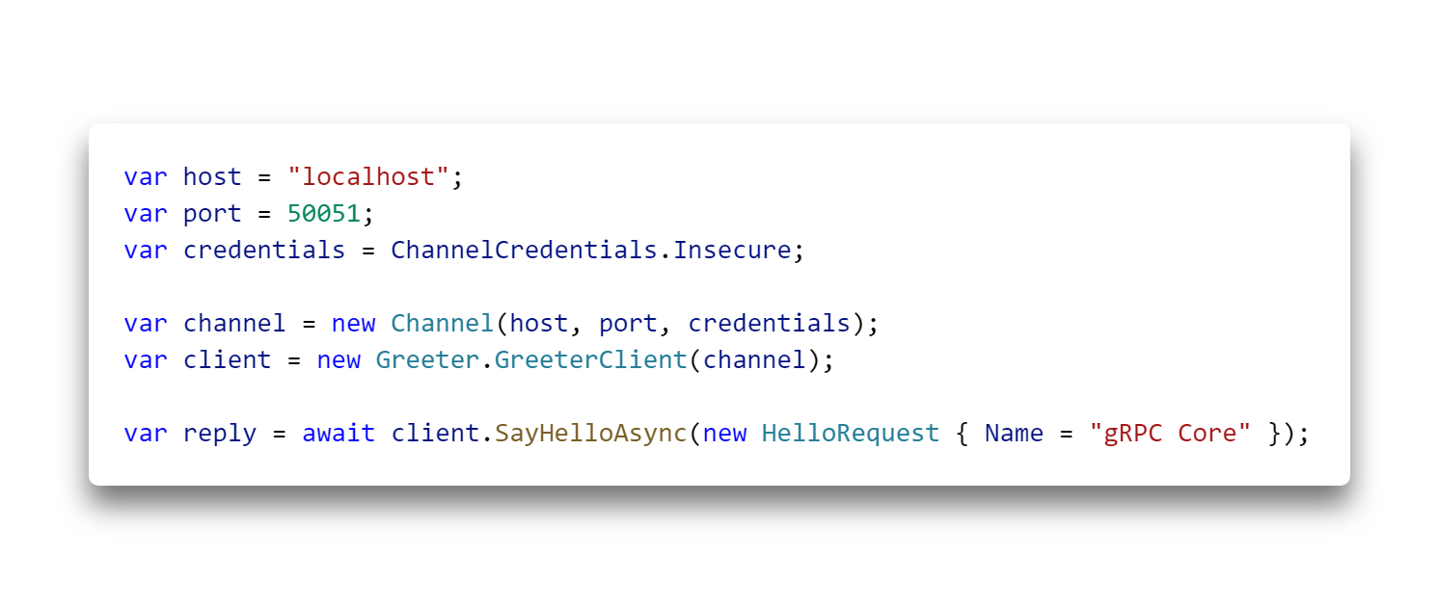
Notes:
A gRPC channel provides a connection to a gRPC server on a specified host and port and is used when creating a client stub (or just “client” in some languages).

Slide 28
Putting it all together grpc-dotnet
Notes:
Managed. Integrates with ASP.NET Core pipeline.

Slide 29
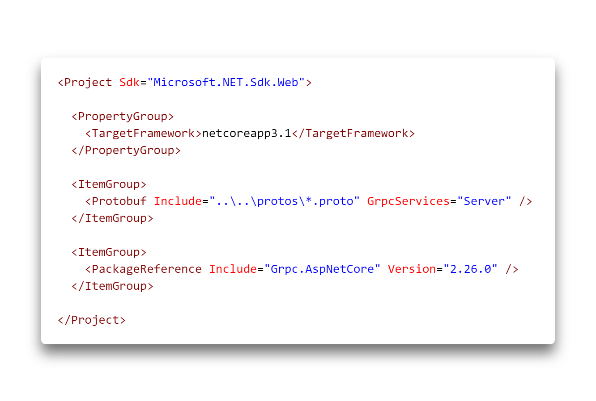

Slide 30
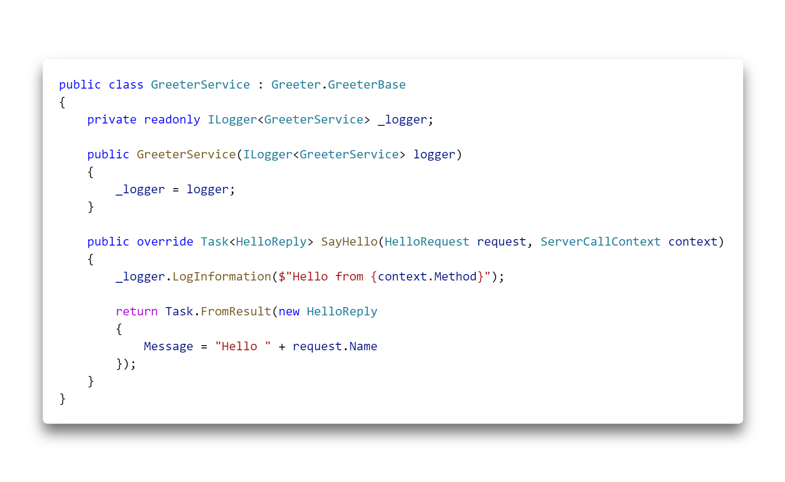

Slide 31
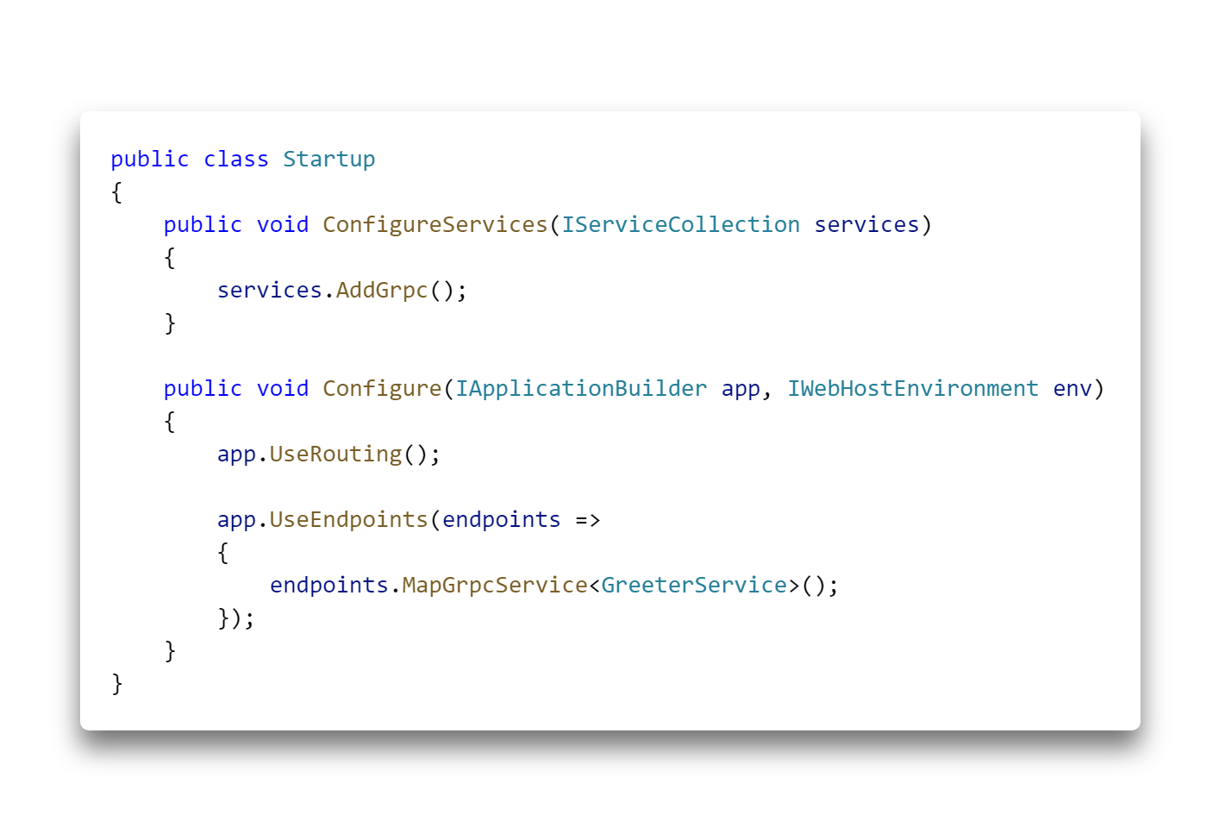

Slide 32
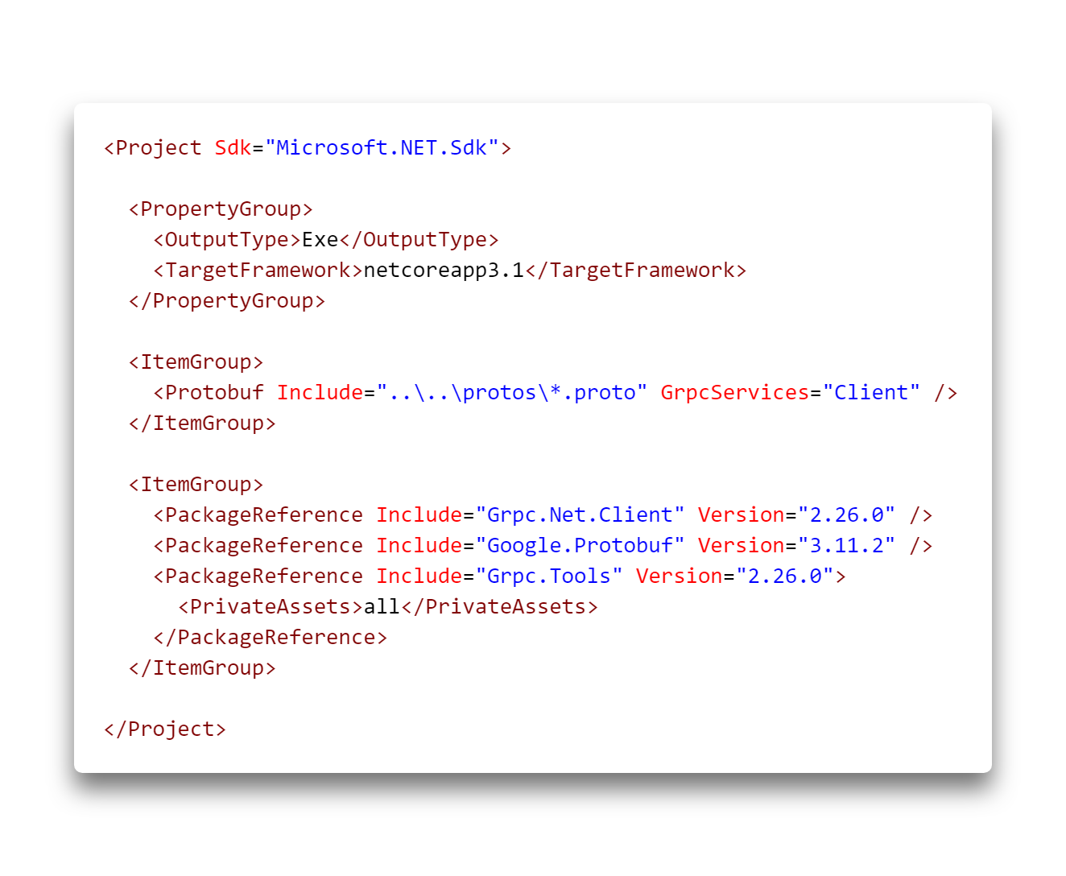

Slide 33
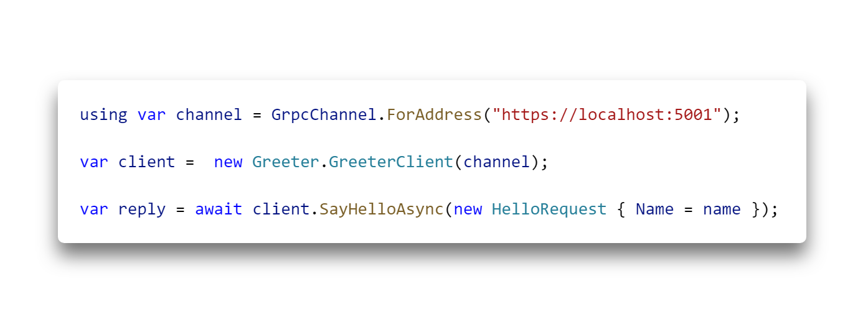

Slide 34
“Code-first” with Protobuf-net.Grpc
Notes:
What if I don’t want to learn protobuf? I don’t care about how my protos look?

Slide 35
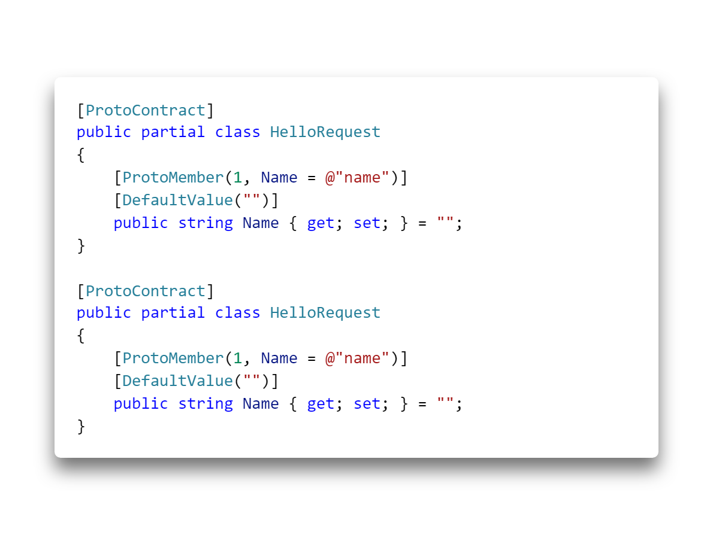
Notes:
Also works with [DataContract] and [DataMember] (Remember Order)

Slide 36
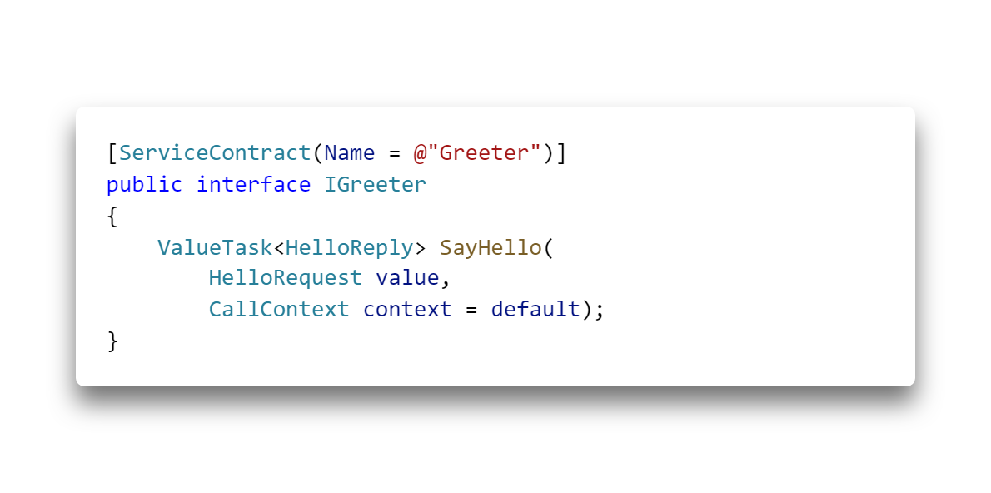
Notes:
ValueTask instead of Task (decreased allocation)
- Understanding the Whys, Whats, and Whens of ValueTask - Stephen Toub
Overall “better” feeling, more .NET like API than Grpc.Core.Api. E.g. streaming.

Slide 37
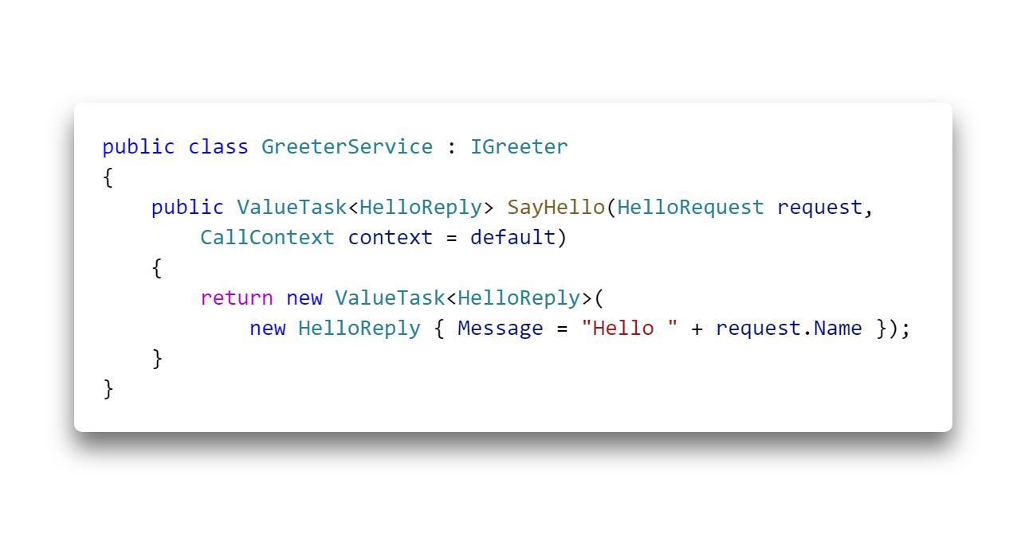

Slide 38
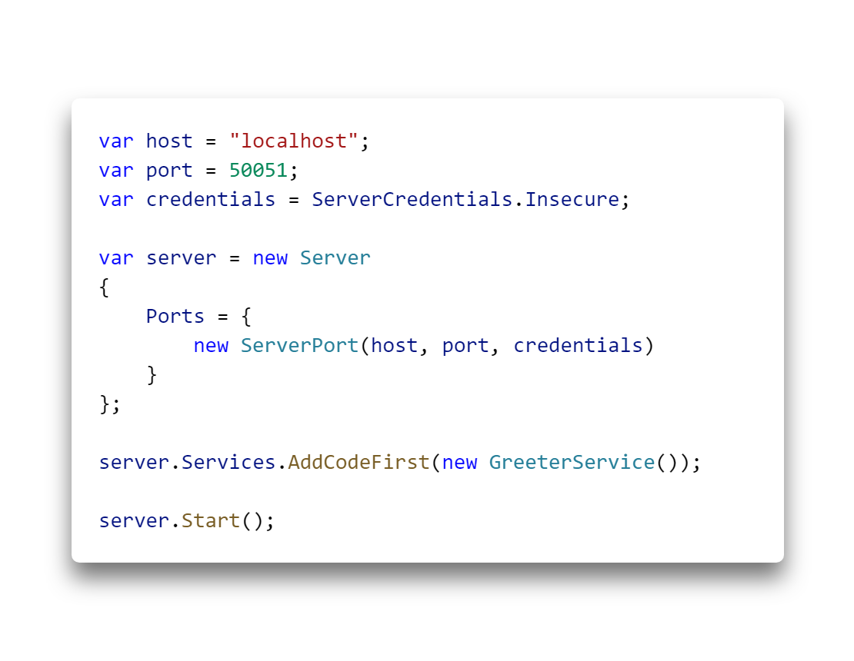

Slide 39


Slide 40
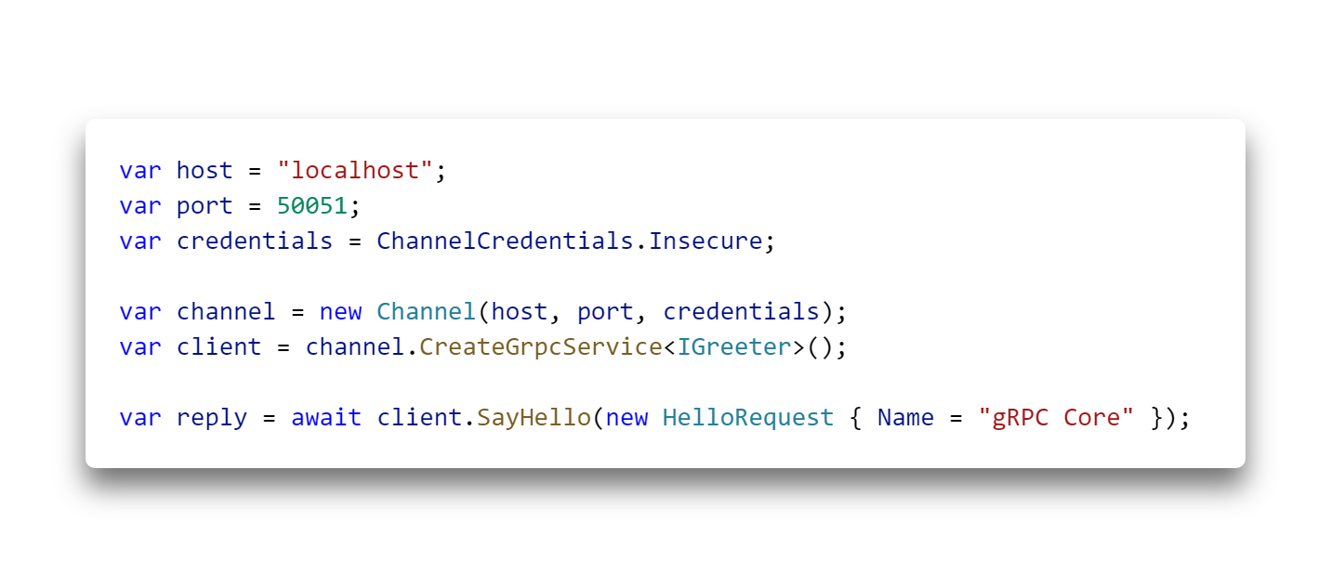

Slide 41
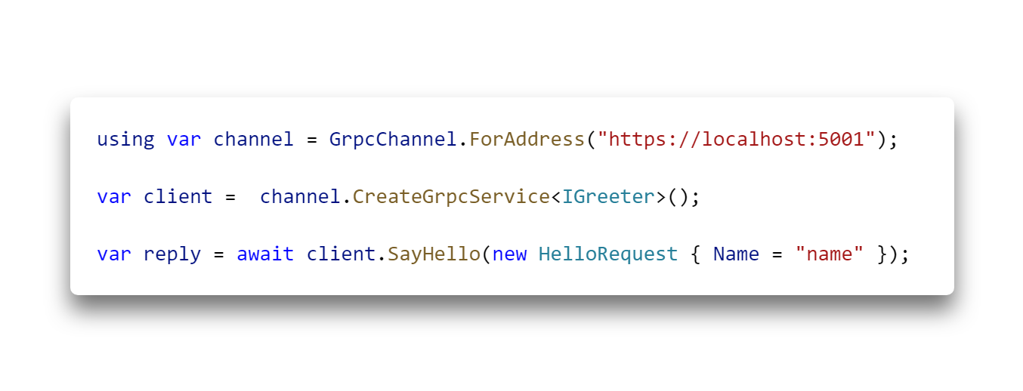

Slide 42
”Code-first” NuGet Packages

Slide 43
grpc-dotnet
Grpc.Core
Grpc.Core.Api
protobuf-net
Shared
Grpc.Core
Grpc.AspNetCore.Server
Grpc.Net.Client
protobuf-net.Grpc.Native
protobuf-net.Grpc .AspNetCore
protobuf-net
protobuf-net.Grpc

Slide 44
grpc-dotnet
Grpc.Core
Grpc.Core.Api
protobuf-net
Shared
Grpc.Core
Grpc.AspNetCore.Server
Grpc.Net.Client
protobuf-net.Grpc.Native
protobuf-net.Grpc .AspNetCore
protobuf-net
protobuf-net.Grpc
Notes:
Native bindings

Slide 45
grpc-dotnet
Grpc.Core
Grpc.Core.Api
protobuf-net
Shared
Grpc.Core
Grpc.AspNetCore.Server
Grpc.Net.Client
protobuf-net.Grpc.Native
protobuf-net.Grpc .AspNetCore
protobuf-net
protobuf-net.Grpc
Notes:
Managed bindings

Slide 46
grpc-dotnet
Grpc.Core
Grpc.Core.Api
protobuf-net
Shared
Grpc.Core
Grpc.AspNetCore.Server
Grpc.Net.Client
protobuf-net.Grpc.Native
protobuf-net.Grpc .AspNetCore
protobuf-net
protobuf-net.Grpc
Notes:
No particular bindings for client.

Slide 47
Types of RPC

Slide 48
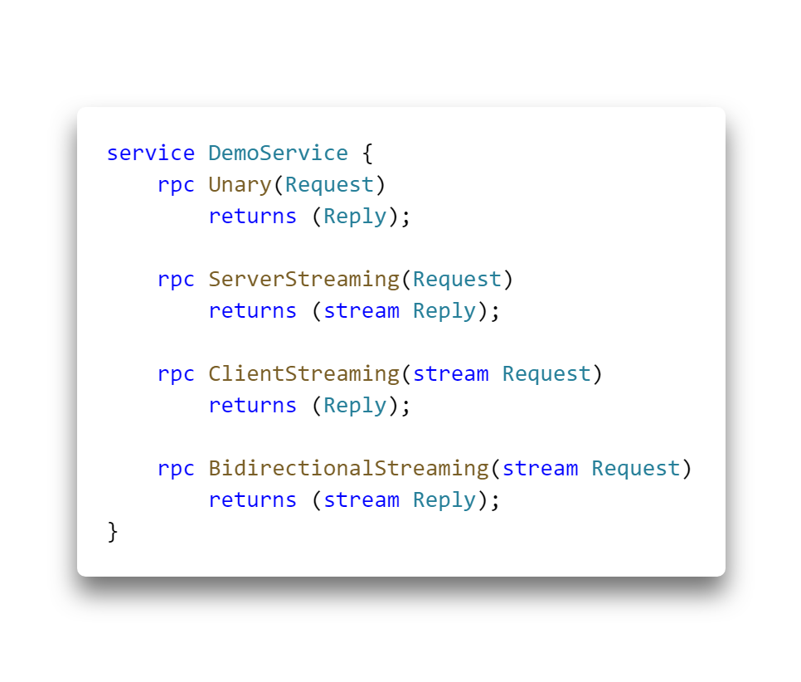
gRPC – Types of RPC
Unary
Server streaming
Client streaming
Bidirectional streaming

Slide 49
Demo
https://github.com/mholo65/grpc-talk
Notes:
25 - 30min
Demo 10min

Slide 50
Hosting
Notes:
35-40min
Because it’s ASP.NET Core, we can host on App Services, right?

Slide 51
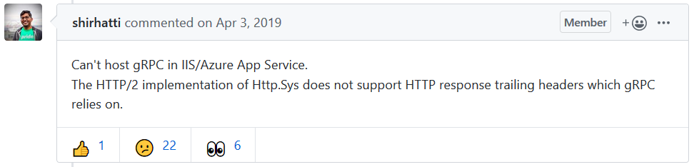
https://github.com/dotnet/aspnetcore/issues/9020
Notes:
Http.sys is the kernel mode driver, in Windows, that handles HTTP requests

Slide 52
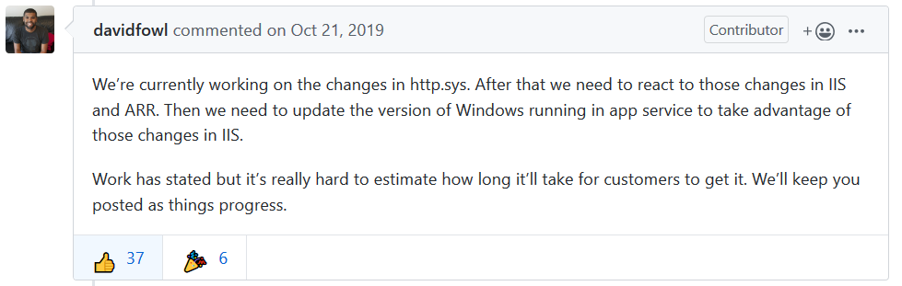

Slide 53


Slide 54
Hosting
IIS and Azure App Services ✘
gRPC-Web ✓ (Preview)
AKS, ACI, Service Fabric or VM ✓
Application Gateway as ingress ✘
Notes:
Browser APIs can’t call gRPC HTTP/2.
It is currently impossible to implement the HTTP/2 gRPC spec in the browser, as there is simply no browser API with enough fine-grained control over the requests.
gRPC-Web offers a compatible alternative.
JavaScript SPAs
.NET Blazor Web Assembly apps
Small performance cost to gRPC-Web, and two gRPC features are no longer supported:
client streaming and bi-directional streaming. (server streaming is still supported!)

Slide 55
Comparison and use cases

Slide 56
gRPC vs. Web API
HTTP/2 vs. HTTP 1.x
Protocol Buffers vs. JSON
Developer productivity
Limited browser support (gRPC-Web)
Not human readable
Notes:
HTTP 1.1 sends data as clear text, HTTP/2 is a binary protocol
Browser -> Server will user HTTP/2 under the hoods if both supports it.
Binary framing and compression. HTTP/2 protocol is compact and efficient both in sending and receiving.
Multiplexing of multiple HTTP/2 calls over a single TCP connection.
Streaming
gRPC-Web (unary + server streaming)

Slide 57
gRPC vs. WCF (Windows Communication Foundation)
HTTP/2 vs. NetTCP, HTTP or MSMQ
Protocol Buffers vs. SOAP/XML, JSON or binary
Not human readable
.NET Core vs. .NET Framework
Port with Visual ReCode
Notes:
Windows Communication Foundation
Microsoft Message Queueing
.NET Binary
Interopability with other languages via SOAP
Windows only (Server side). CoreWCF – Not production ready.
Microsoft recommends porting to gRPC
ASP.NET Core gRPC for WCF Developers – Mark Rendle (Visual ReCode)

Slide 58
gRPC recommended scenarios
Low latency, highly scalable, distributed systems
Point-to-point real-time communication
Polyglot environments
Mobile APIs
Notes:
Great for lightweight microservices where efficiency is critical
Excellent support for bi-directional streaming. gRPC services can push messages in real time without polling
Supports most popular development languages, making it a good choice for multi-language environments
Mobile (or edge devices) communicating with cloud.

Slide 59
Summary

Slide 60
Summary
Grpc.Core vs. grpc-dotnet
Contract-first vs. Code-first
Microservices and Mobile
Hosting
Notes:
Side note, protobuf-net can use Contract-first.
Protobuf-net has “better API”, e.g.
Async enumerable vs Async Stream Reader
ValueTask vs Task (minimize allocations)
E.g. ServiceStack gRPC uses Protobuf-net

Slide 61

Thank You!
@mholo65

